Slide 1


John Lee
1/12/2026

Slide 2

Outline
Executive Summary
Introduction
Methodology
Results
Conclusion
Appendix

Slide 3
Executive Summary
Summary of methodologies
Data Collection API with Web Scraping
Data Wrangling
Exploratory Analysis Using SQL
EDA with Visualization
Interactive Dashboard with Plotly Dash
Machine Learning
Logistic Regression
Support Vector Machines
Decision Tree Classifier
K-nearest neighbors
Summary of all results
With all four machine learning models, we were able to achieve 83% accuracy. Specifically, we correctly predicted all 12 successful landing but incorrectly predicted 3 failure as success.

Slide 4
Introduction
Project background and context
Spacex is dedicated to cut cost of sending manned missions to Space by reusing the first stage. However, not all the first stages landed successfully. The key question is to determine if the first will land so the company can determine the cost of a launch.
Problems you want to find answers
To predict if the first stage will land successfully

Slide 5

Section 1

Slide 6
Methodology
Executive Summary
Data collection methodology:
Data was collected from SpaceX using the SpaceX API and from Wikipedia.org with Web Scraping
Perform data wrangling
We checked the missing data and created a landing outcome label (success/failure)
Perform exploratory data analysis (EDA) using visualization and SQL
Perform interactive visual analytics using Folium and Plotly Dash
Perform predictive analysis using classification models
We built four models (Logistic regression, SVM, Decision Tree, and KNN) and used Grid search to find the best parameters. Models are evaluated using Accuracy and Confusion Matrixes.

Slide 7
Data Collection
Describe how data sets were collected.
Data sets were collected from SpaceX using SpaceX API and from Wikipedia using Web Scraping

Slide 8
Data Collection – SpaceX API
GitHub URL of the completed SpaceX API calls notebook https://github.com/johnl402399-cmd/testrepo/blob/main/jupyter-labs-spacex-data-collection-api.ipynb
Request and parse the SpaceX launch data using the GET request
Filter the dataframe to only include Falcon 9 launches
Dealing with Missing Values

Slide 9
Data Collection - Scraping
GitHub URL of the completed web scraping notebook
https://github.com/johnl402399-cmd/testrepo/blob/main/jupyter-labs-webscraping.ipynb
Request the Falcon9 Launch Wiki page from its URL
Extract all column/variable names from the HTML table header
Create a data frame by parsing the launch HTML tables

Slide 10
Data Wrangling
1. Calculate the number of launches on each site
2. Calculate the number and occurrence of each orbit
3. Calculate the number and occurrence of mission outcome of the orbits
4. Create a landing outcome label from Outcome column
GitHub URL of your completed data wrangling related notebooks
https://github.com/johnl402399-cmd/testrepo/blob/main/labs-jupyter-spacex-Data%20wrangling.ipynb

Slide 11
EDA with Data Visualization
Draw plots to see how features affect the launch outcome
FlightNumber and Payload variables (scatter plot for relationship)
FlightNumber and Launch Site (scatter plot for relationship)
Payload Mass and Launch Site (scatter plot for relationship)
Flight Number and Orbit Type (scatter plot for relationship)
Payload Mass and Orbit Type
Success rate of each orbit type: Orbit Type and Success Rate (bar plot for categories)
Success Yearly Trend: line plot for trend
GitHub URL : https://github.com/johnl402399-cmd/testrepo/blob/main/edadataviz.ipynb
Summarize what charts were plotted and why you used those charts
Add the GitHub URL of your completed EDA with data visualization notebook, as an external reference and peer-review purpose

Slide 12
EDA with SQL
Display the names of the unique launch sites in the space mission
Display 5 records where launch sites begin with the string 'CCA'
Display the total payload mass carried by boosters launched by NASA (CRS)
Display average payload mass carried by booster version F9 v1.1
List the date when the first successful landing outcome in ground pad was achieved
List the names of the boosters which have success in drone ship and have payload mass greater than 4000 but less than 6000
List the total number of successful and failure mission outcomes
List all the booster_versions that have carried the maximum payload mass, using a subquery with a suitable aggregate function.
List the records which will display the month names, failure landing_outcomes in drone ship ,booster versions, launch_site for the months in year 2015.
Rank the count of landing outcomes (such as Failure (drone ship) or Success (ground pad)) between the date 2010-06-04 and 2017-03-20, in descending order.
GitHub URL: https://github.com/johnl402399-cmd/testrepo/blob/main/jupyter-labs-eda-sql-coursera_sqllite.ipynb

Slide 13
Build an Interactive Map with Folium
Map objects created and added to a folium map
Add a circle for each launch site in data frame launch_sites (make the sites visible)
Mark the success/failed launches for each site on the map (make success and failed launches visible on the map)
Calculate the distances between a launch site to its proximities (see the environment around the sites)
GitHub URL: https://github.com/johnl402399-cmd/testrepo/blob/main/lab_jupyter_launch_site_location.ipynb

Slide 14
Build a Dashboard with Plotly Dash
1. Display success launches by site for all sites in a pie plot
2. Display success launches for a specific site in a pie plot
3. Display how payload mass affects success launch by booster version in a scatter plot
4. Allow to change payload mass range
GitHub URL: https://github.com/johnl402399-cmd/testrepo/blob/main/spacex-dash-app.py

Slide 15
Predictive Analysis (Classification)
Four models (logistic regression, SVM, decision tree, and KNN) are built and evaluated using accuracy and confusion matrixes. These modes have similar performance.
Flowchart
Obtain data from url = https://cf-courses-data.s3.us.cloud-object-storage.appdomain.cloud/IBM-DS0321EN-SkillsNetwork/datasets/dataset_part_3.csv
Standardize the data
Split the data X and Y into training and test data
Create a GridSearchCV object to find the best Parameters
Caculate accuracy and confusion matrixes
GitHub URL: https://github.com/johnl402399-cmd/testrepo/blob/main/SpaceX_Machine%20Learning%20Prediction_Part_5.ipynb

Slide 16
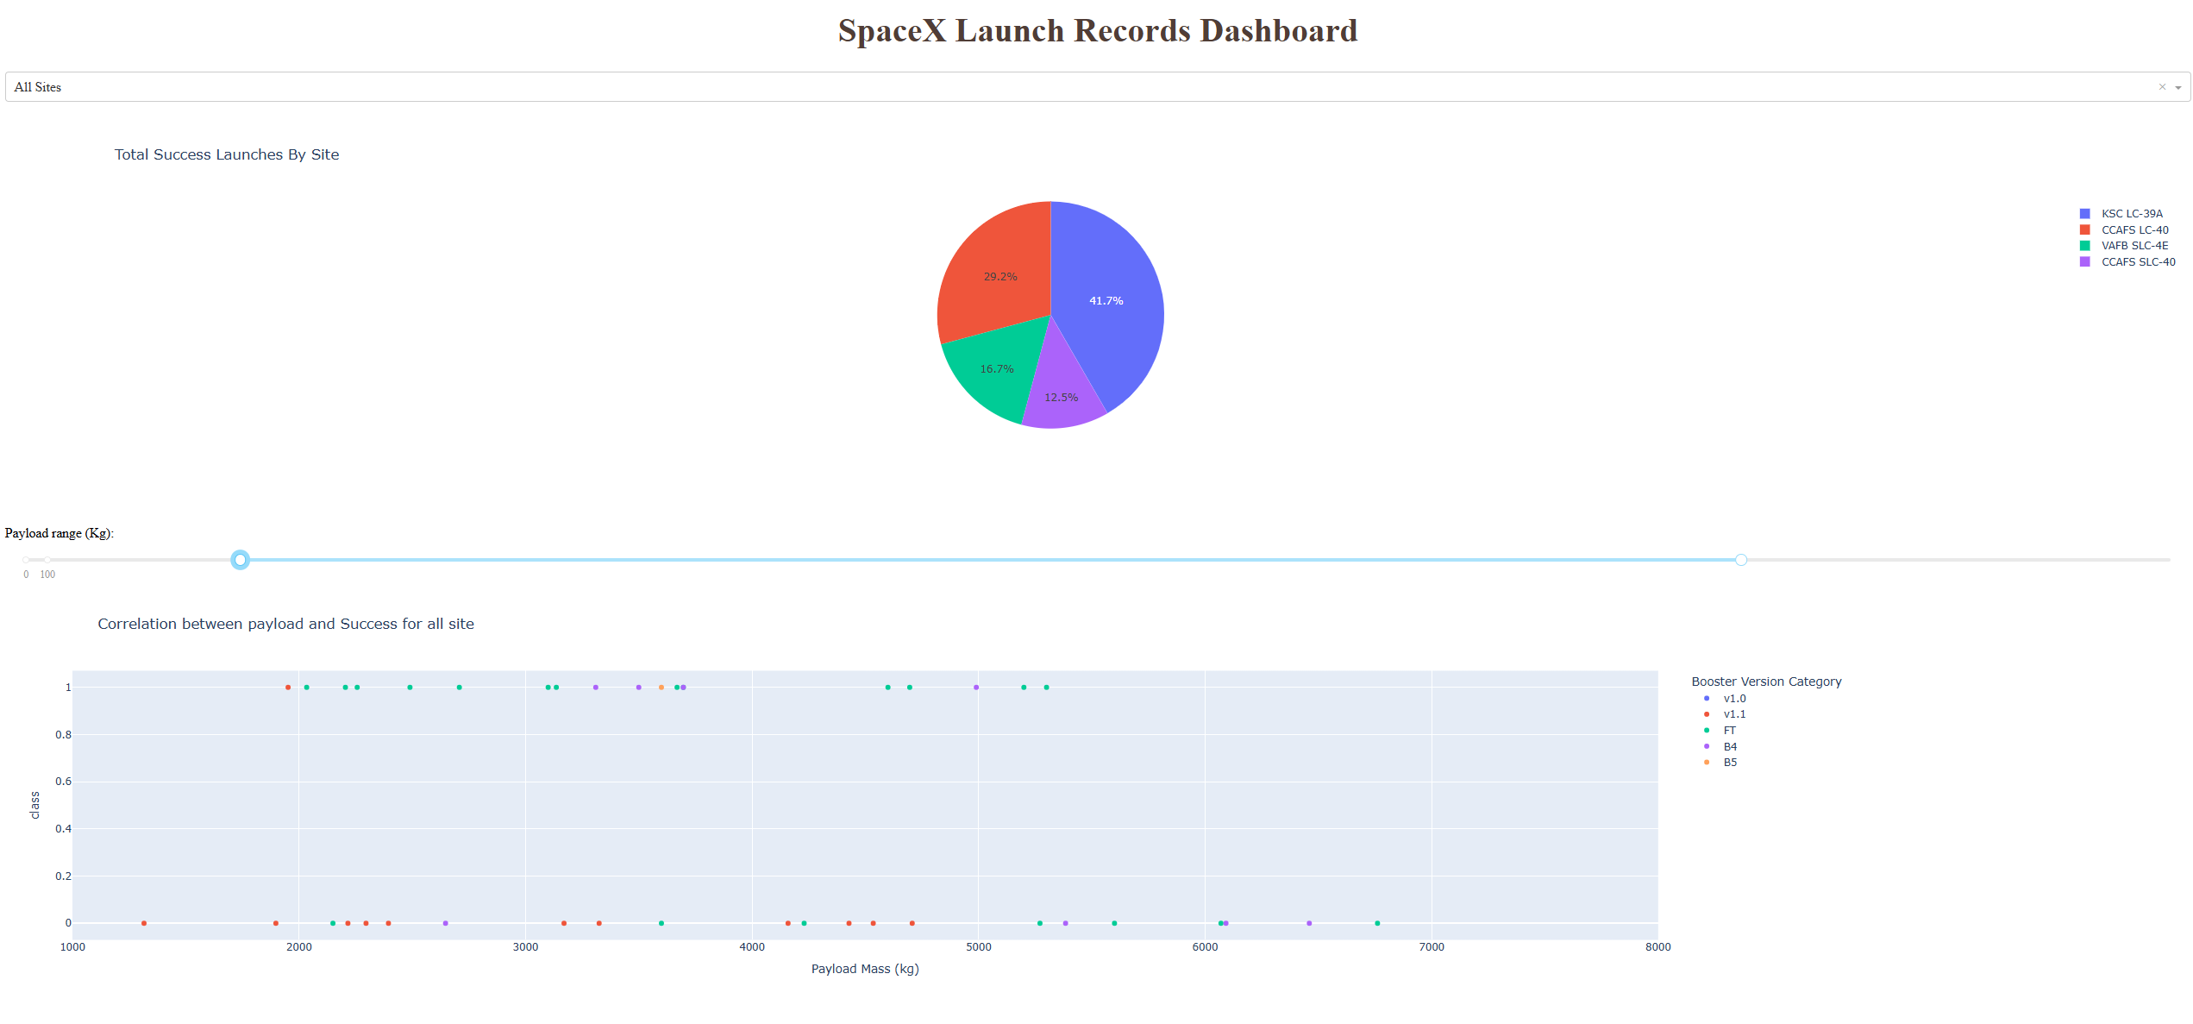
Results
Exploratory data analysis results
Success rate improves after years
Differ Orbit Types seem to have different success rates, but need more data to verify the assumption
Right is a demo of Interactive analytics
Predictive analysis results
We can predict about 84% success rate

Slide 17

Section 2

Slide 18
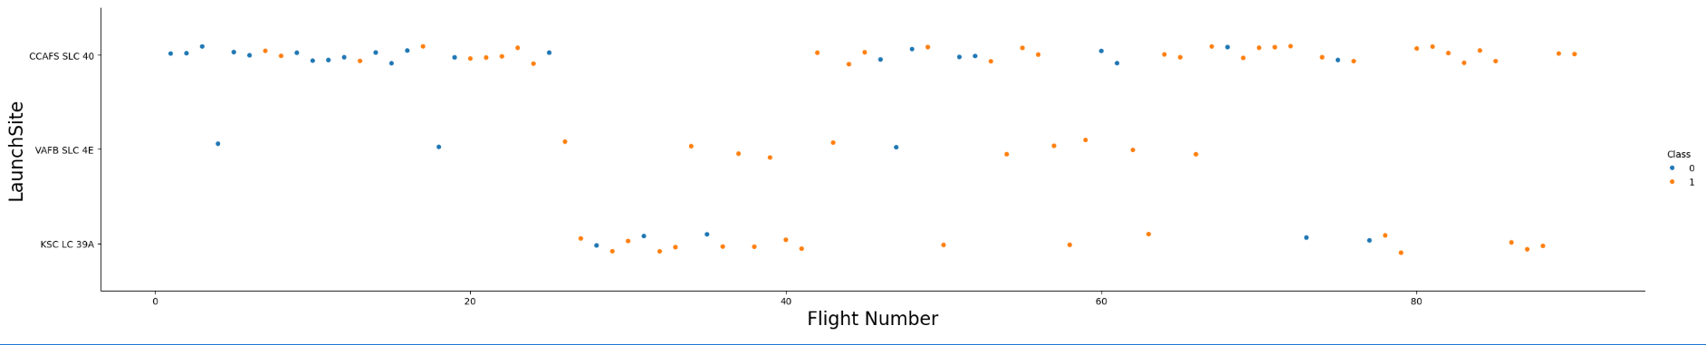
Flight Number vs. Launch Site
More recent flights have higher success rates
Site impacts are minor

Slide 19
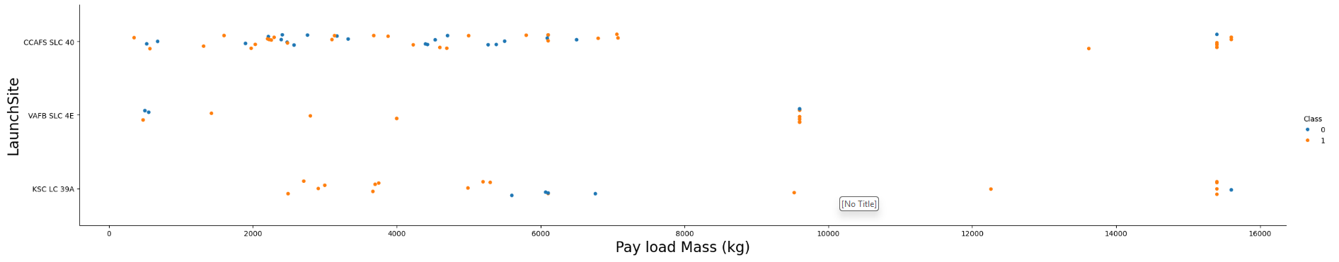
Payload vs. Launch Site
For the VAFB-SLC launch site there are no rockets launched for heavy payload mass(greater than 10000).
No conclusion on the relationships can be reached.

Slide 20
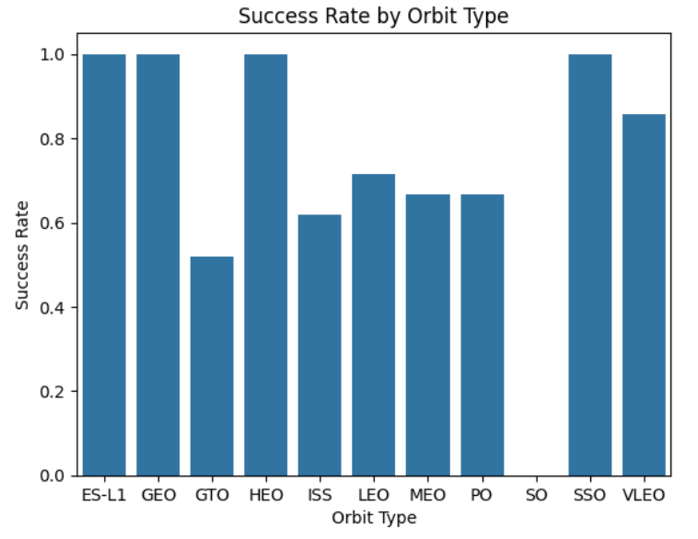
Success Rate vs. Orbit Type
ES-L1, GEO, HEO, and SSO orbit types have 100% success rate

Slide 21
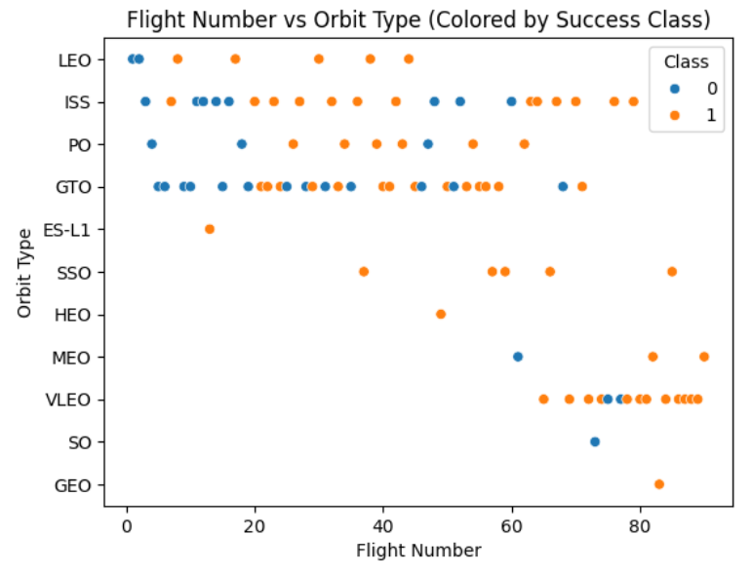
Flight Number vs. Orbit Type
Some orbit types have 100% success rate, but they just have limited cases
As years going, there is higher success rate for all types

Slide 22
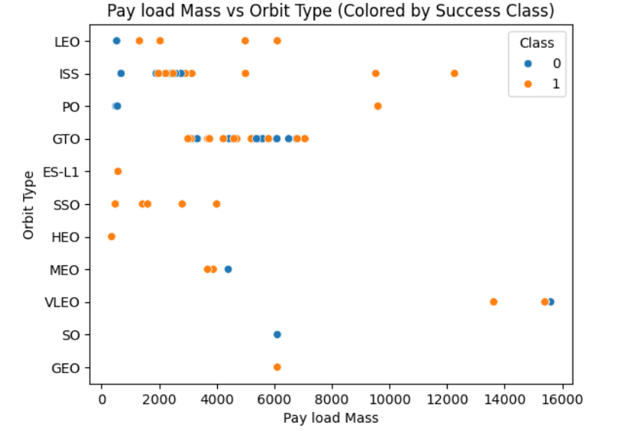
Payload vs. Orbit Type
Pay load mass seems have little impact on success rate

Slide 23
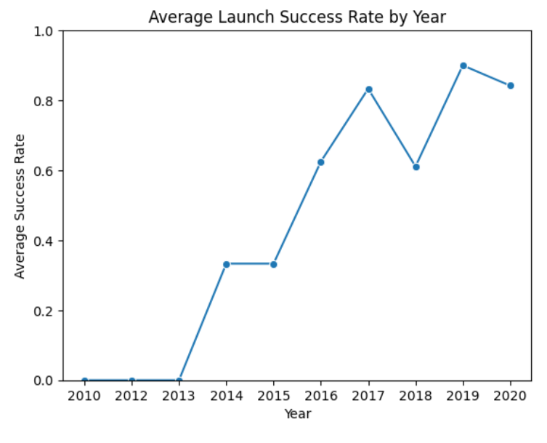
Launch Success Yearly Trend
Success rate generally improves as years increase
The start point was in 2013
There is drop in 2018

Slide 24
All Launch Site Names
Launch_Site
CCAFS LC-40
VAFB SLC-4E
KSC LC-39A
CCAFS SLC-40

Slide 25
Launch Site Names Begin with 'CCA'
CCAFS LC-40
CCAFS LC-40
CCAFS LC-40
CCAFS LC-40
CCAFS LC-40

Slide 26
Total Payload Mass
45596.0 KG

Slide 27
Average Payload Mass by F9 v1.1
avg(PAYLOAD_MASS__KG_) Booster_Version
2928.4 F9 v1.1
500.0 F9 v1.1 B1003
2216.0 F9 v1.1 B1010
4428.0 F9 v1.1 B1011
2395.0 F9 v1.1 B1012
570.0 F9 v1.1 B1013
4159.0 F9 v1.1 B1014
1898.0 F9 v1.1 B1015
4707.0 F9 v1.1 B1016
553.0 F9 v1.1 B1017
1952.0 F9 v1.1 B1018

Slide 28
First Successful Ground Landing Date
2015-12-22

Slide 29
Successful Drone Ship Landing with Payload between 4000 and 6000
Booster_Version PAYLOAD_MASS__KG_
F9 FT B1022 4696
F9 FT B1026 4600
F9 FT B1021.2 5300
F9 FT B1031.2 5200

Slide 30
Total Number of Successful and Failure Mission Outcomes
98

Slide 31
Boosters Carried Maximum Payload
Booster_Version PAYLOAD_MASS__KG_
F9 B5 B1048.4 15600
F9 B5 B1049.4 15600
F9 B5 B1051.3 15600
F9 B5 B1056.4 15600
F9 B5 B1048.5 15600
F9 B5 B1051.4 15600
F9 B5 B1049.5 15600
F9 B5 B1060.2 15600
F9 B5 B1058.3 15600
F9 B5 B1051.6 15600
F9 B5 B1060.3 15600
F9 B5 B1049.7 15600

Slide 32
2015 Launch Records
Date Booster_Version Launch_Site
01 F9 v1.1 B1012 CCAFS LC-40
04 F9 v1.1 B1015 CCAFS LC-40

Slide 33
Rank Landing Outcomes Between 2010-06-04 and 2017-03-20
Landing_Outcome count(Landing_Outcome)
No attempt 10
Success (drone ship) 5
Failure (drone ship) 5
Success (ground pad) 3
Controlled (ocean) 3
Uncontrolled (ocean) 2
Precluded (drone ship) 1
Failure (parachute) 1

Slide 34

Section 3

Slide 35
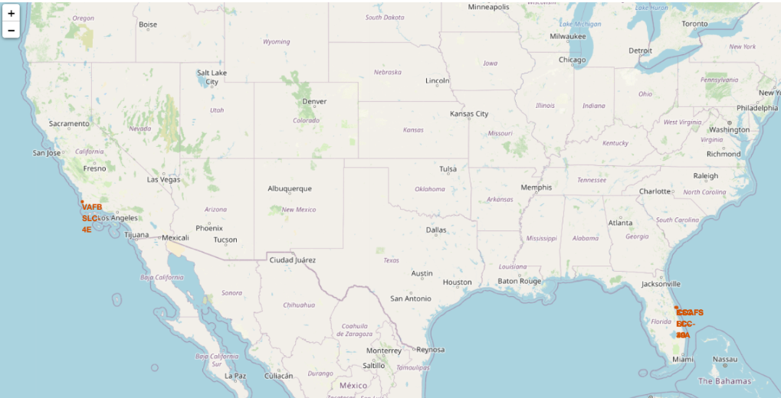
Launch Sites

Slide 36
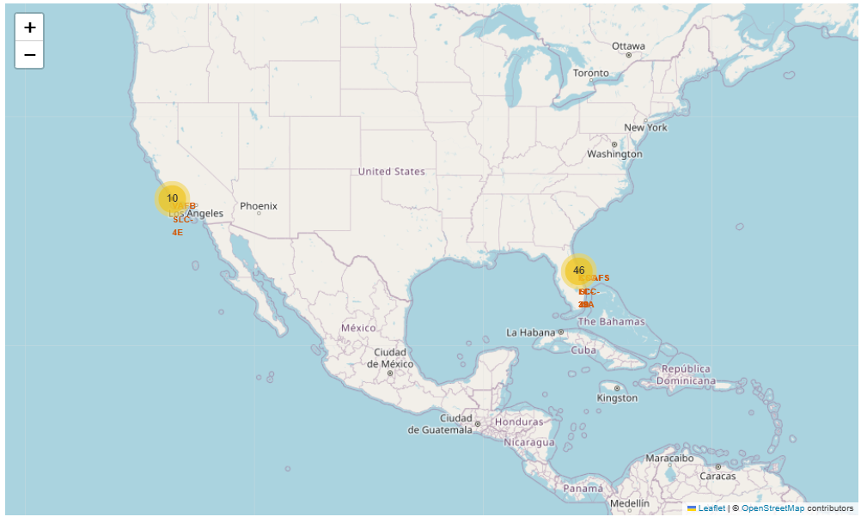
Success/failed launches for each site

Slide 37
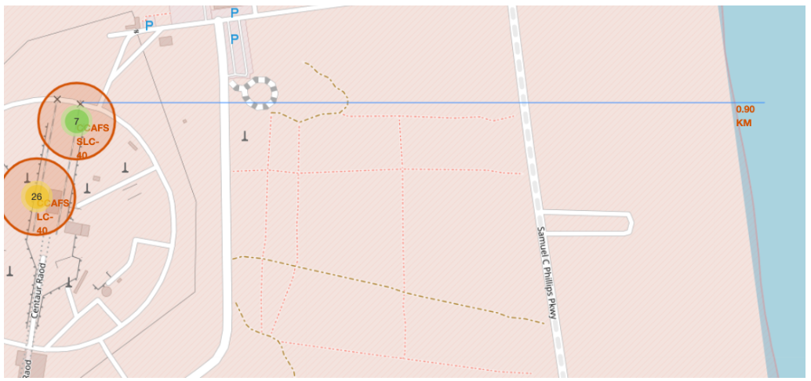
Distance of CCAFS to the coastline

Slide 38

Section 4

Slide 39
Total Success Launches By Site

Slide 40
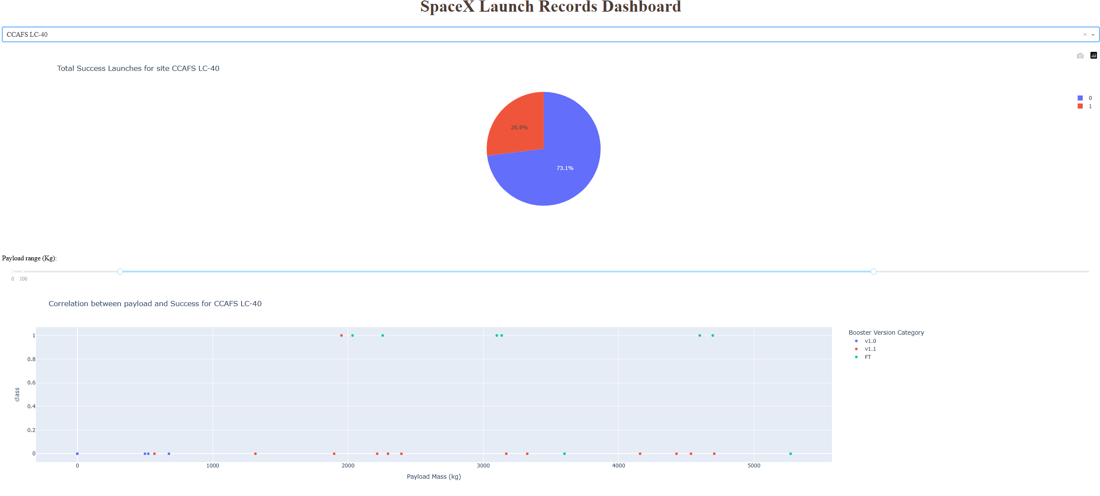
Total Success Launches for site CCAFS LC-40

Slide 41
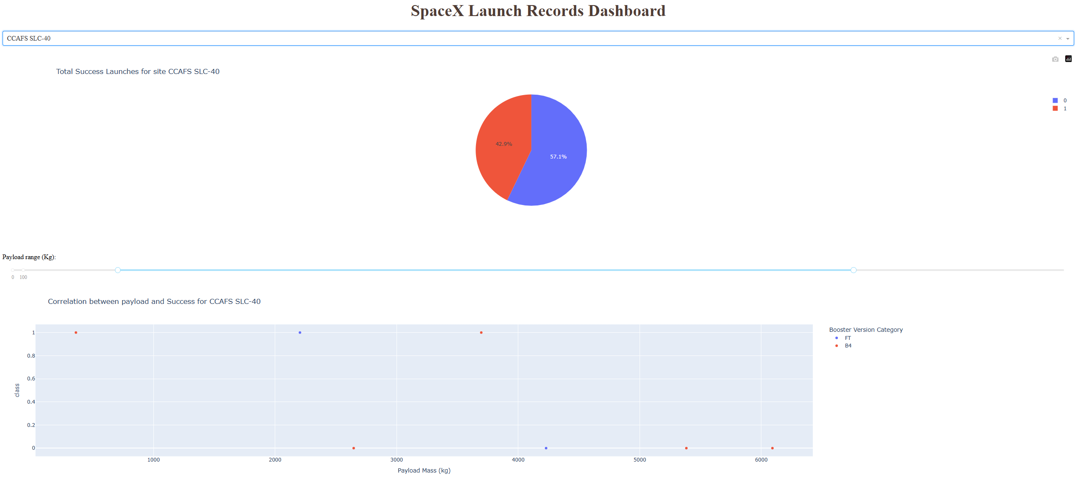
Total Success Launches for Site CCAFS SLC-40

Slide 42

Section 5

Slide 43
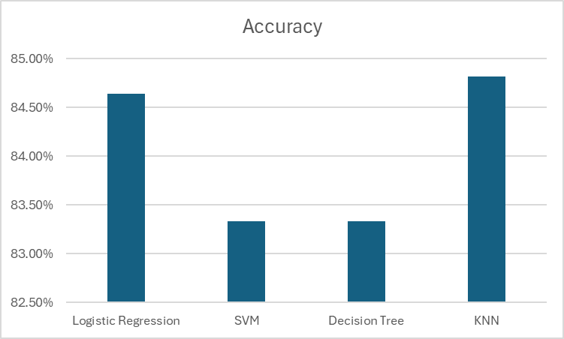
Classification Accuracy
KNN model has the highest accuracy.

Slide 44

Confusion Matrix

Slide 45
Conclusions
Success rate improves after years
Differ Orbit Types seem to have different success rates, but need more data to verify the assumption
We can predict about 84% success rate

Slide 46
Appendix
Detailed files and data sets can be provided at request

Slide 47


